Slide 1
MOTION MAN
TEAM 7:
PHILIP GILLEY
ZAF CETO
CLAY MULLIS
GAETANE JULMISTE

Slide 2
STORY BOARD
Genre of Motion-Man® is a platformer. Initially user has no tools. User controls a man who is in motion, (running, walking, jumping etc.) throughout the game. He receives more tools throughout different levels. He will eventually come to a finish line, and whichever user has the highest score, is the winner. We will keep a database of high-scores.

Slide 3
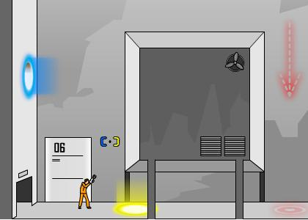

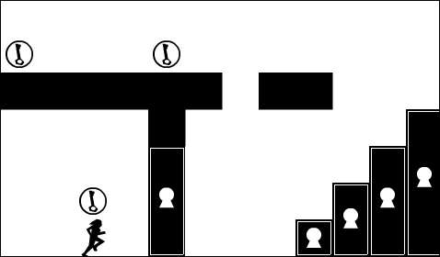
SCREEN SHOTS

Slide 4
USE CASES FOR THE FIRST RELEASE
First release will have:
Game menu
Physics/Motion of character
First 3 levels
Optional: 1 tool

Slide 5
DEVELOPER FOR EACH TASK
Designing the first level on paper – Clay, Gaetane
Researching for the best engine built for XNA- Zaf, Philip, Gaetane, Clay
Designing player motion – Gaetane
Implement the first level with the engine – Zaf, Philip
Implement menu- Philip
Level 2 and 3 – Philip , Clay
User’s first tool - Zaf

Slide 6
TIME TO COMPLETE EACH TASK:
1st level designed on paper (week 1)
Picking engine and getting familiar with it (week 1)
Possible engine: Tomahawk
Combine first level with the engine (week 1 and 2)
Level 2 and 3 (week 3)
Add first tool (week 4)

Slide 7
APIs/Toolkits available
Framework: Microsoft XNA Game development environment
API: Microsoft Visual Studio 2010
Language: C#
Platform: Microsoft Windows®

Slide 8
Log of meetings:
First meeting- 01-24-2012 Everyone attended. Discussed the types of possible games.
Second meeting- 01-26-2012 Everyone attended.
Discussed the game engines
Third meeting – 01-28-2012 Everyone attended.
Divided the task onto members, deadlines have been set.

